Slide 1
How to search the element in array ?
momedaram

Slide 2
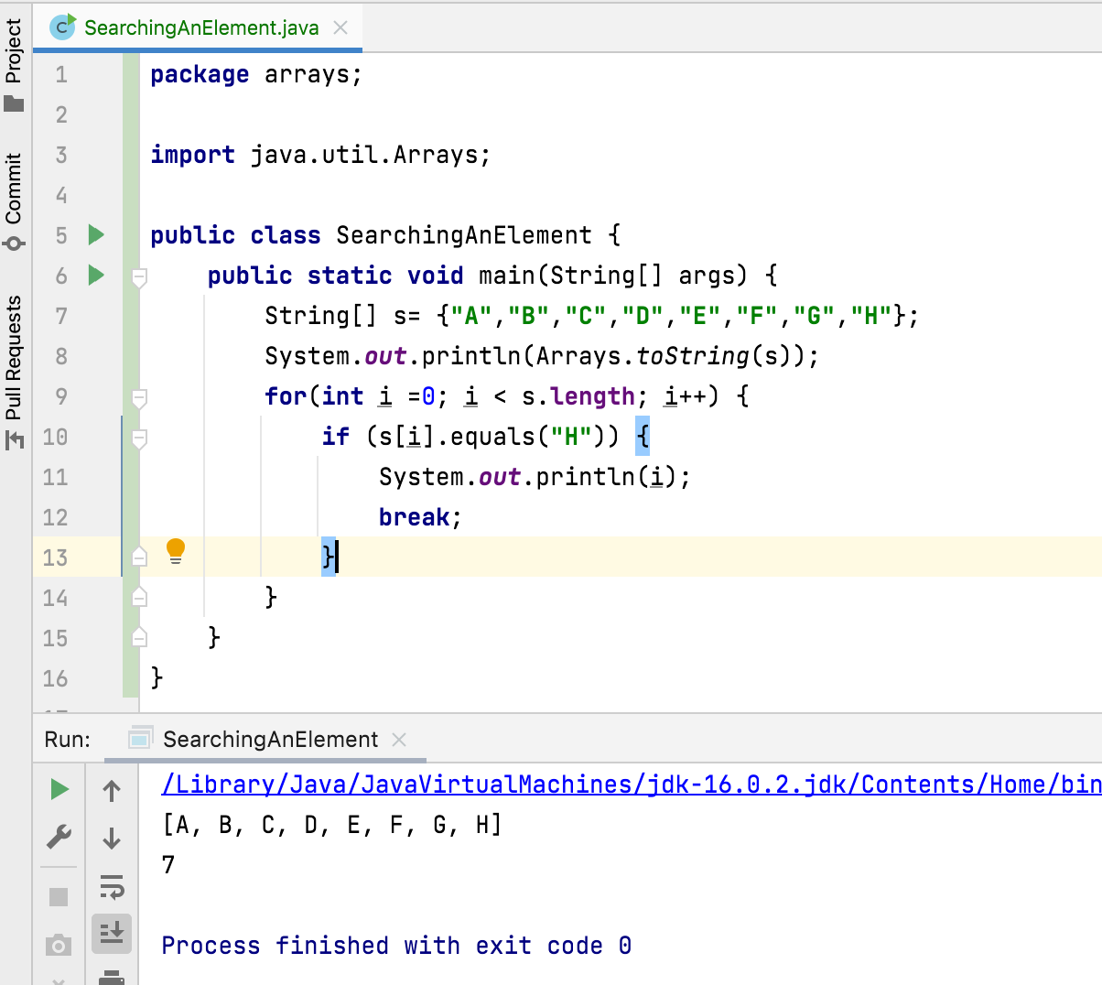

Slide 3
How to search the element in array ?
Arrays.binarySearch()
Searches the specified array for the specified value using the binary search algorithm.
The array must be sorted before calling this method. If it is not sorted, the results will be undefined.
If the element is found in the array, it returns index of that element in the array.
If the element is not found, it returns (-n-1).
If the array contains multiple elements same as specified value, there is no guarantee which one will be return.

Slide 4
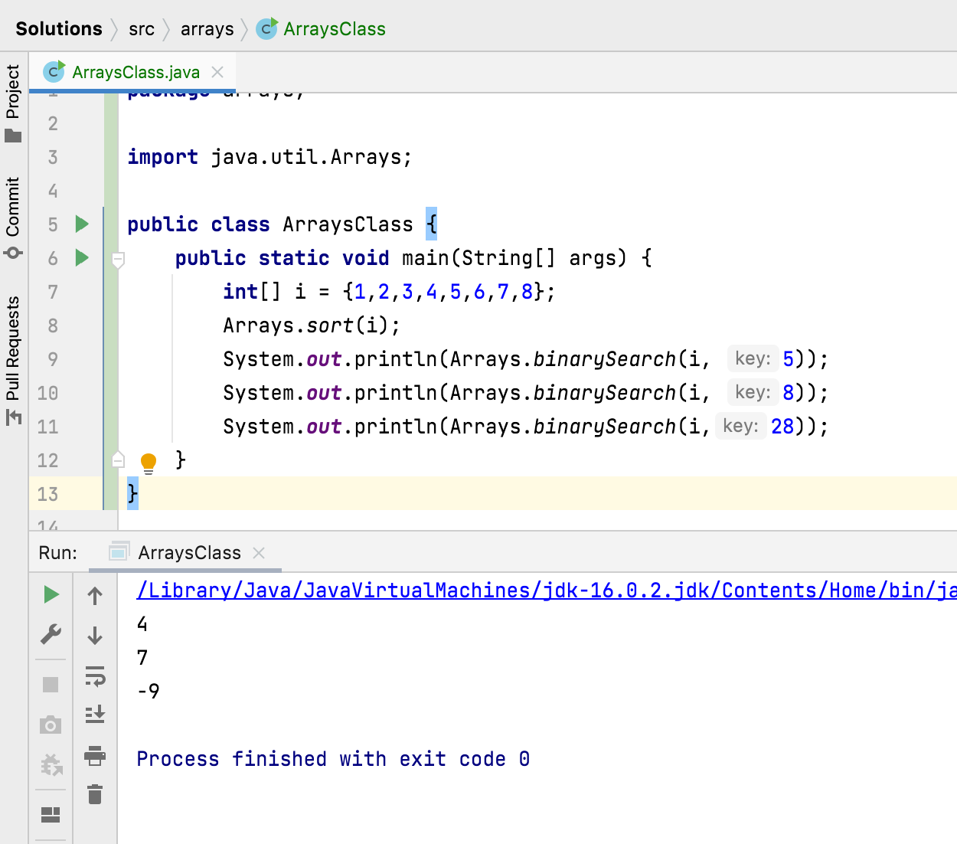

Element we want to search
array

Slide 5
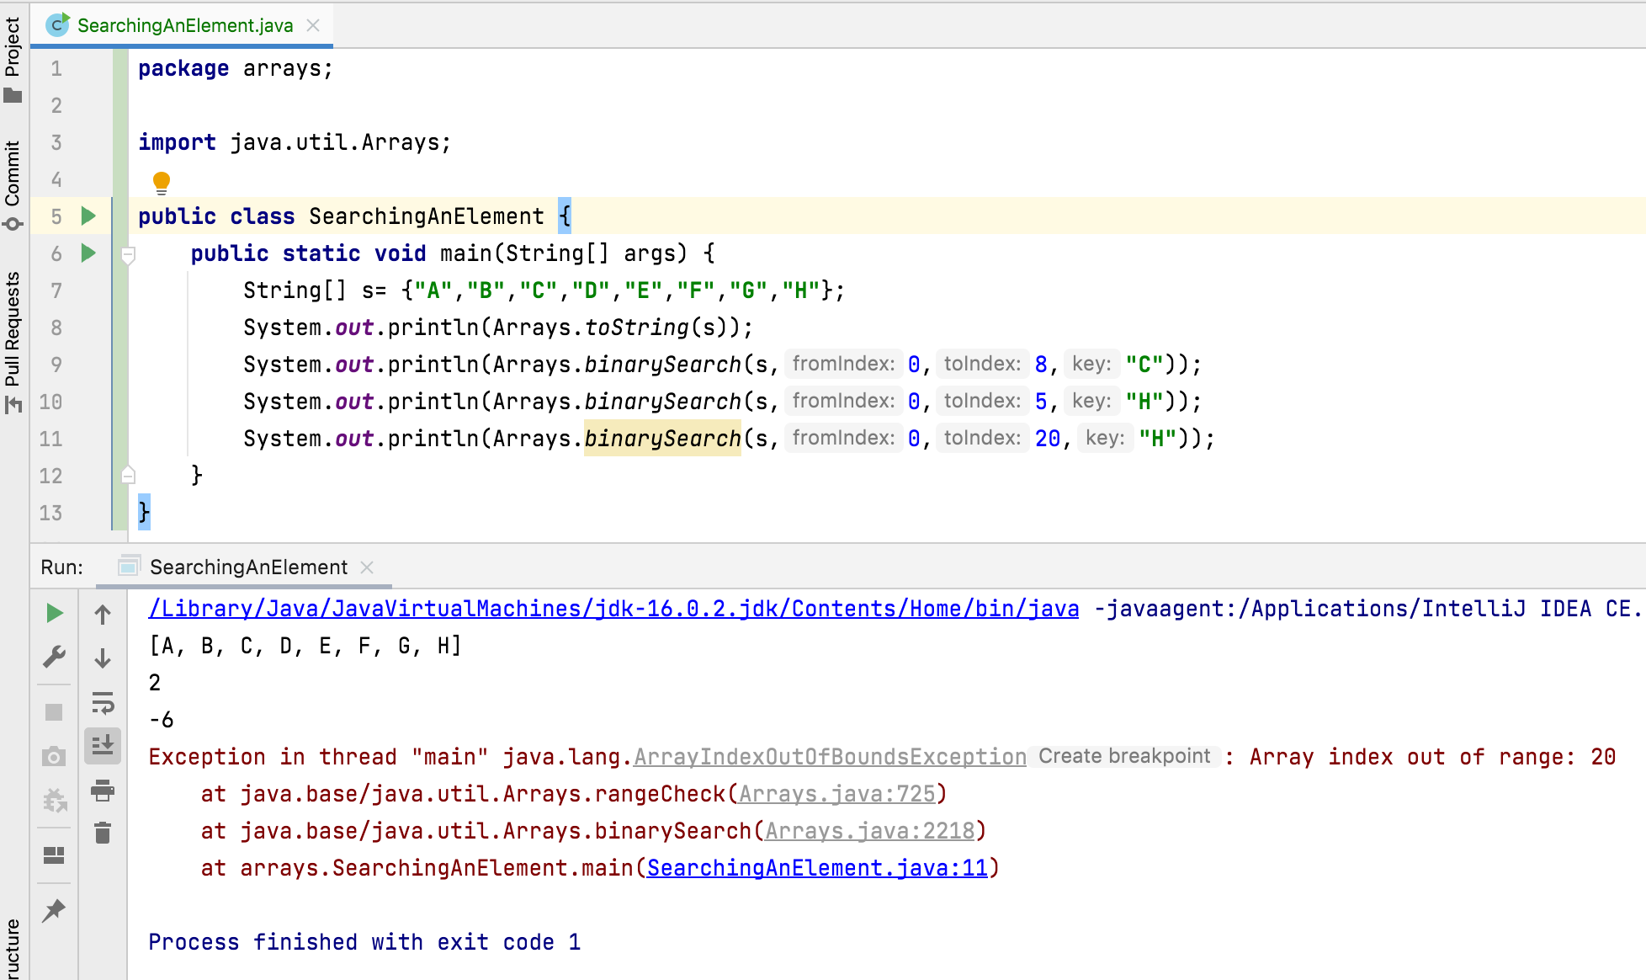

Slide 6
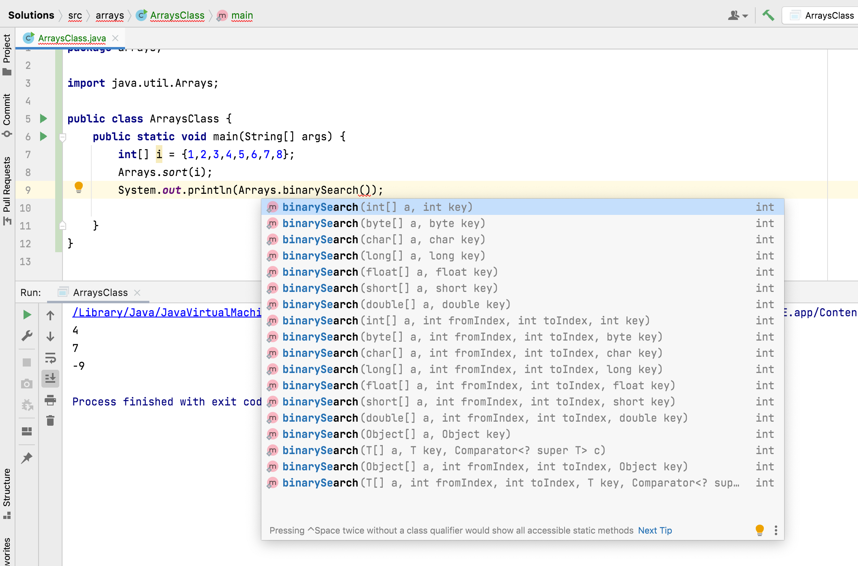

Slide 7
Thank You!
momedaram

